Slide 1
H-WIN Kick Off meeting!
Wednesday, November 17, 2021

Slide 3
WAF Background
Funding round 8.0

Slide 4
Innovating with Human Centered Design (HCD) for Homeless and Workforce System Redesign $135,800 from CWDB ♦ April 2020-March 2022
Systems-level changes to connect clients in the homeless system of care to employment and career resources
Methodology: Human Centered Design
Integration and Partnership

Slide 5
HCD Coach
Workforce Development Board
Lived Experience Consultant
Hope Solutions
Martinez Adult Education
Rubicon Programs
The HCD Team
SparkPoint
SHELTER, Inc.
Health, Housing & Homeless Services

Slide 6
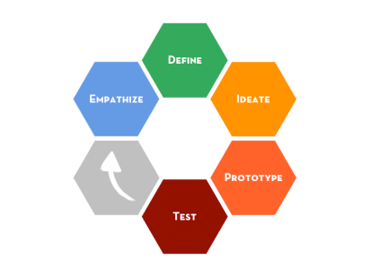
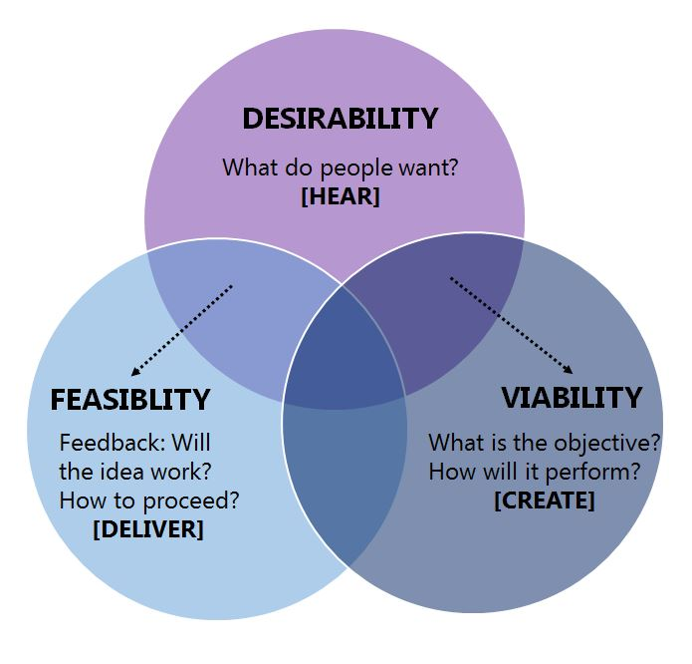
Human-Centered Design

Slide 7
Workforce seat on Council on Homelessness
Asset Map showing connected systems
Cross-trainings (recorded)
Housing & Work Peer Learning Community
Two Workgroups

Slide 8
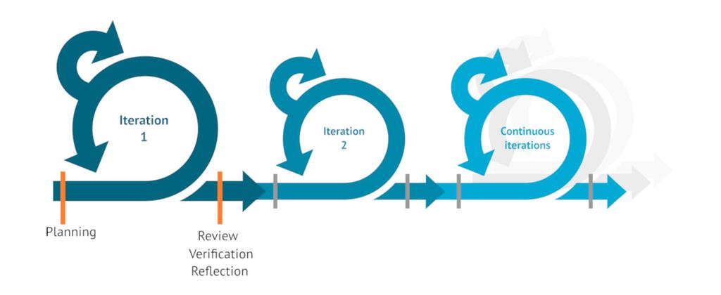
Final Steps…
Testing and implementing solutions
Employer Education Forum – February 8, 2022
White paper and share-out on our REPLICABLE, SCALABLE SOLUTIONS

Slide 9
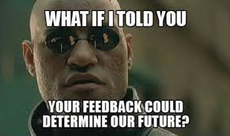
(Survey results)

Slide 11
(For service providers)
(For clients)

Slide 12
Other
Build teams of two-encourage coffee meetings to help build relationships with the organizational members
Looking at data together, asking questions about what we see;
Contact information sheets, with name, contact, company, role, short bio to take away and build out connections (could be digital);

Slide 14
If yes, are there particular topics, efforts, populations or type of services you would like to see in an arc?
Employment/Employers
Getting jobs for clients who are homeless
Developing relationships with employers...Preparing employers and job seekers for mutual benefit.
I would support career pathway building and any strategies on how to find employers for youth who are leaving Juvenile Hall, are homeless, and have IEP’s.
Employment services or organizations that work with the homeless. Also job agencies that employ individuals who are mentally ill.
Sustainable career pathways, workforce partner surveys, building culturally relevant training programs.

Slide 15
If yes, are there particular topics, efforts, populations or type of services you would like to see in an arc? (continued)
Specific Populations
Marginalized housed youth [k-12th and Transitional Age Youth]/families
Justice involved, foster youth, homeless youth
Age-specific services (kids, families, young adults, elders, etc...)
Currently incarcerated individuals needing work and homeless. Not waiting until they are released to start plans and services and warm hand offs.
Immigrant communities, unaccompanied minors, school-based services, emergency housing
efforts to support transitional age youth with housing and jobs. It would be great to build collaborative efforts within our organizations, so that we can build on the expertise and resources of all the partners and organization
culturally specific response including age, LGBTQ, special needs

Slide 16
If yes, are there particular topics, efforts, populations or type of services you would like to see in an arc?
Housing:
Transitional House
sanction encampment
Engagement
Engaging folks to enter services, maintaining housing, exiting services
Homeless accepting help
Developing training or materials for clients/consumers/end users
Collaboration
Connecting agencies to collaborate on direct referrals (homelessness, housing, employment, benefits, etc).
Misc
Community Service Fairs or any topics that require additional time for planning and follow-up.
provider self care

Slide 17
What would make this meeting one you would NOT want to miss?
Specific Outcomes
That it is more than just informational and talking, but that action takes place even if it is to try different things and they don't work the first time.
Relevant useful actionable information
Outcomes
if it led to more clients getting jobs, and if it helped the system's elements to collaborate to provide more jobs and careers to clients
Broad spectrum of knowledge and opinions that are solution based and have calls to action
Affordable housing for un-documented people
Agenda should be specific to what participants will take away
Agenda Setting
Purpose of meetings and network clearly articulated
If there was a presentation / information that I was really interested in
A real commitment to finding real solutions to bridging this gap / Problem solving
A focus on the homeless sector
agency updates, potential employers, and topic focus
involvement, information sharing, interaction, progress and outcomes

Slide 18
What would make this meeting one you would NOT want to miss?
Innovation
Unique or new approaches. We all have similar intentions.
Innovative ideas
Something new
Training
Dynamic training
Training/information
Logistics
Snacks
My schedule flexibility
No more than 2 hours long. If in person, in a place that's easily accessible (for people with disabilities) with comfortable chairs and snacks.
Collaboration/Networking
Contacts with organizations
honest and heartfelt efforts from all partners in the room where we can build a community of people that share the same values
resources, developing a direct link with other agencies, developing a directory of member agencies to include service, programs, eligibility, and referral mechanism
networking updates
Opportunities to form new partnerships or collaborations
useful networking
capacity building with workforce partners
Resource Sharing
Resources
information/resource sharing

Slide 19
Additional Feedback
Group agree on key assumptions we are making
Does the network use a systems-view on the work, and/or do we use a client-centered approach? Or an employer focused approach?
How do we want to collaborate (what does/can this look like?) and to what end?
Concern about meetings that requires too much outside "work". There are times where as an ED I am not able to take on additional projects, even as a part of a group. My best voice is what I share in the meetings.
We need more in-depth information about partner agencies and updates to their programs/services.
Opportunities to collaborate on specific clients/cases.
Sometimes people are not able to share ideas in big groups, but do great working with others one-on-one, so I would encourage small group discussion.
Also, if I was the meeting leader, I'd spend time building relationships amongst group members, so we might have to do small team projects.
Include presentations and tours to our particular organizations
Manage the agenda of the meetings, so that not one organization is weighing in on all the decision making.
Create way to comment or share privately or anonymously, by using Paddle or other way of sharing.
The chicken or the egg…people need a job to pay the rent or they need a place to live in order to get a job?

Slide 24
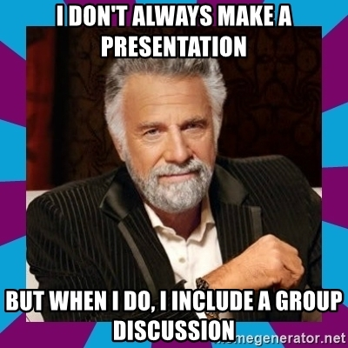
Group Discussion

Slide 25
Things to Decide
Next meeting:
In Person or Remote?
If in person, who hosts?
When?
Responsibilities:
Host
Jaime/Maureen
Survey
ID key issues
Develop format/process for future meetings

Slide 26
Next Steps

