Slide 1
California’s Child Support Program Contra Costa County

Slide 2
Program Mission
We listen to, respect and support our customers so that children can receive the emotional and financial support they need to thrive.

Slide 3
How We Have Changed!
No longer under the District Attorney
Court focusing on best interest of the child
DCSS remains neutral
Caseworkers empowered to resolve most issues without court involvement
High focus on quality customer service
Notes:
An existing child support order may be modified upward or downward if there is a change:
A significant increase or decrease in either parent’s earnings
A change in custody or the amount of time the child spends with each parent
A change in any other factor that would affect the child support guideline
If a parent becomes disabled, loses their job, or perhaps goes to jail, they need to contact our department as soon as possible. Unless the child support order is modified, the current child support amount is still due and will result in unpaid support, plus interest.
Either parent may request a review of their child support order.
A modification may be justified if the support order would change by 20% or $50

Slide 4
Basic Steps to Child Support Process
Case Opening
Communication with both parties
Needs assessment
Establish paternity, child support or review existing court order
Set up accounting, if appropriate
Work with parties/employers for consistent payments
Ongoing support including change of circumstance needs
Provide assistance to both parties for the life of the child support case

Slide 5
Debt Reduction Program
Provides eligible parents to reduce arrears owed to the state
Reduction in parents’ arrears will be based on income and assets
Arrears may be paid off all at once or over time in a payment plan based upon the details of your case.
Apply by visiting your local agency for an application to be completed and returned by mail or in person.
https://childsupport.ca.gov/overview/debt-reduction-program/

Slide 6
Family Reunification
If a Parent Paying Support is in-compliance with active Family Reunification, current child support shall not be charged for any active months
Communication with DCSS is vital to ensure any charge adjustments are made
If Family Reunification is not successful, charges will NOT be added to months when Reunification was active and in-compliance
If Family Reunification is successful, parent should contact DCSS as there are additional programs that may waive arrears owed to the state

Slide 7
How You Can Help Your Client!
Encourage contact with DCSS to discuss concerns and questions
Reinforce the importance of them being a part of the process and communicating with caseworkers
Be knowledgeable on services available
Share Customer Service oriented mindset
Emphasize the importance their support means in their child’s life

Slide 8
Value of Community Partnerships
Knowledge increases ability to support clients
Reduces barriers
Expedites resolutions
Builds trust
Opens opportunities for future collaboration & growth

Slide 9
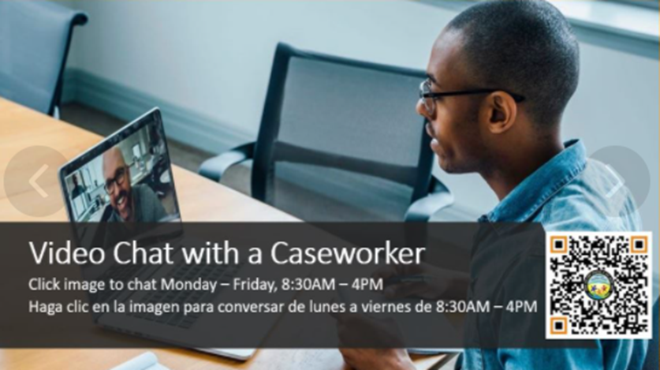
New Ways to Get Information
VIC , our Virtual Information Center has answers to your general question 24/7!!
Virtual Chat with a caseworker Monday-Friday 8:30-4:00
Visit VIC @ www.cccdcss.us

Slide 10
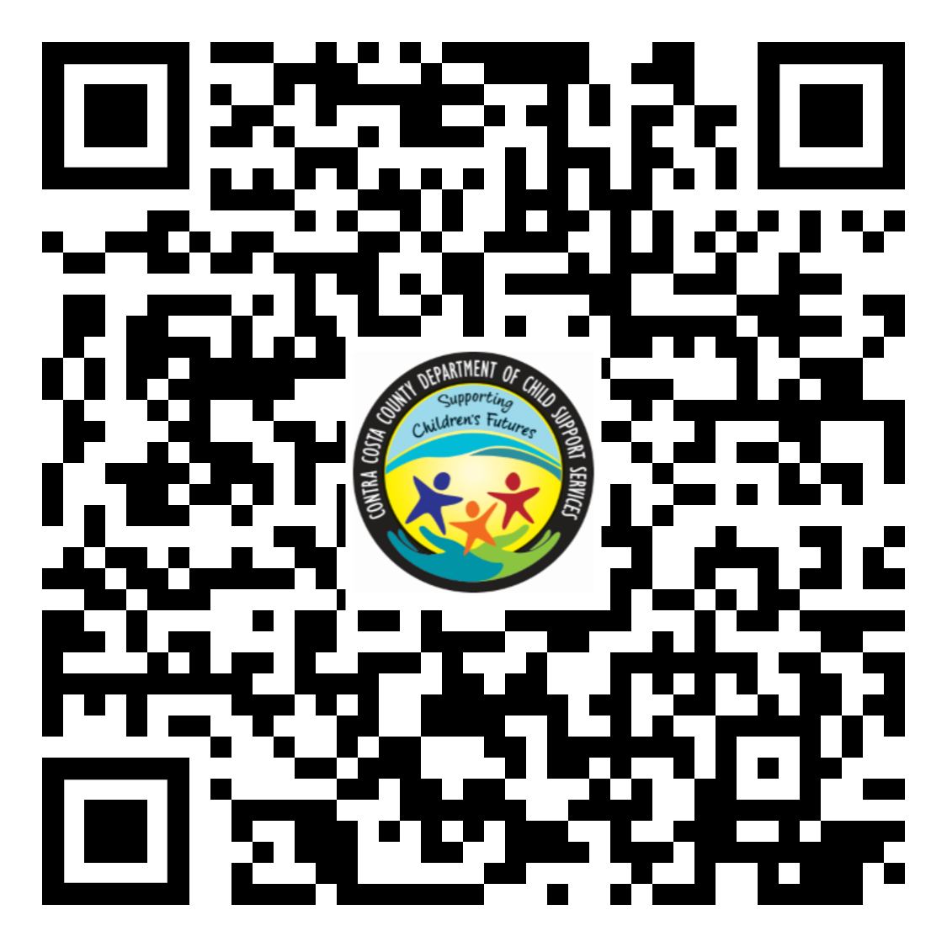
How to Reach Us
Our office is located at 50 Douglas Drive, Suite 100, Martinez, CA 94553, from 8:00 am to 4:30 pm Monday through Friday
Phone hours are 8:00 am to 4:45 pm Monday through Friday. Telephone # 1 -(866) 901-3212
Video Chat from 8:00 am to 4:30 pm Monday through Friday @ www.cccdcss.us
Text number- (925) 268-8429
Fax number - (925) 335-3636

Slide 11
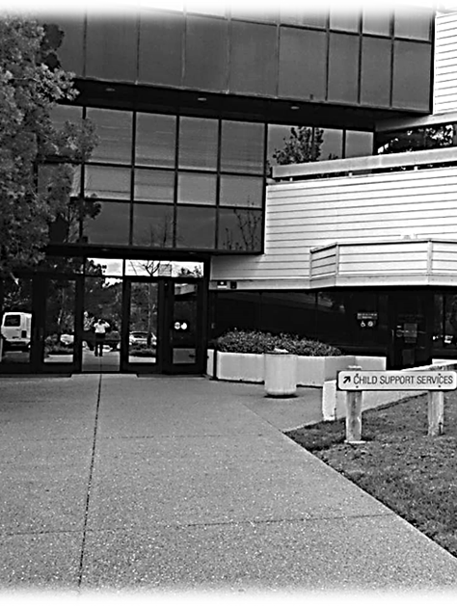
Contra Costa County Department of Child Support Services
Jamie Luna
Outreach & Marketing Coordinator
Jamie.Luna@dcss.cccounty.us
925-957-7380
Email us at -childsupport@dcss.cccounty.us.
Check us out on Facebook

